Slide 1
Self-care messages
2024

Slide 2
UEC - 111
NHS 111 can book you an appointment for urgent healthcare. Visit www.111.nhs.uk, call 111 or use the NHS app.
NHS 111 will direct you to the right place to meet your medical needs. You can go online at www.111.nhs.uk, call or use the NHS App.
If you need urgent medical help but you're not sure where to go, contact NHS 111. They will assess you and direct you to the right service. Go online at www.111.nhs.uk, call or use the NHS App.
Did you know NHS 111 can book you an arrival slot at an emergency department? If your condition is not life-threatening, they may direct you to another service that’s more appropriate, or where you can be seen sooner. Go online at www.111.nhs.uk, call 111 or use the NHS App.

Slide 3
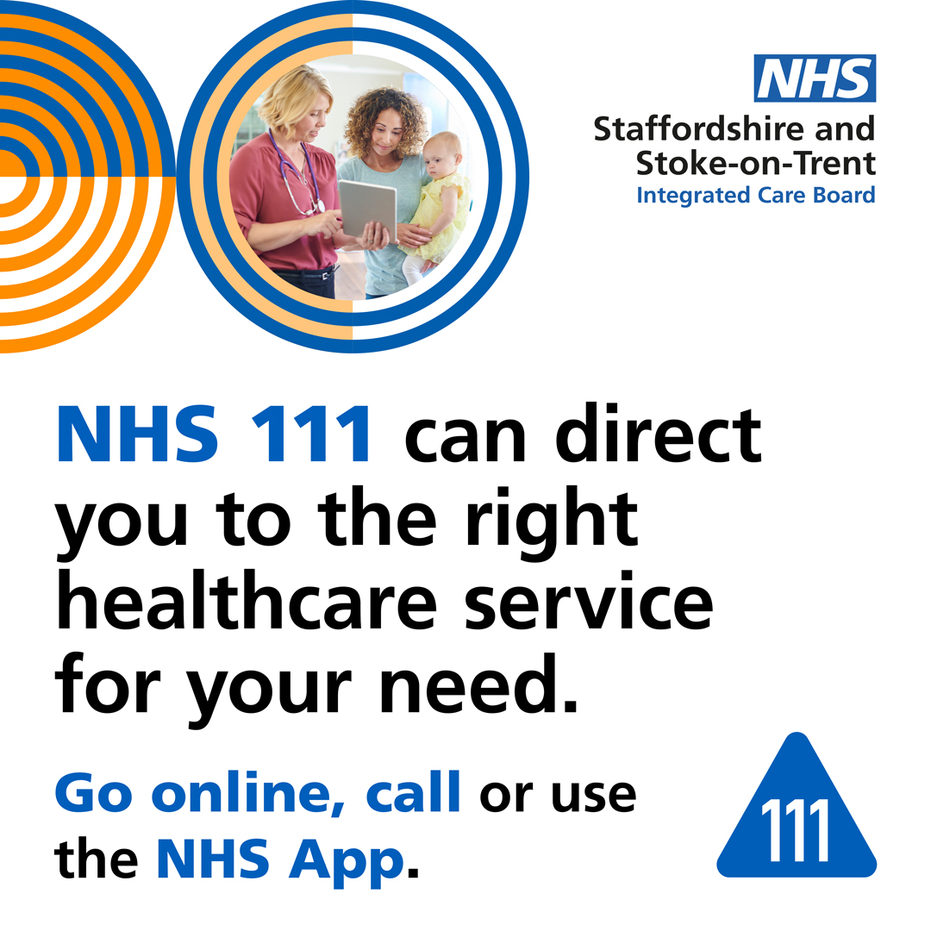
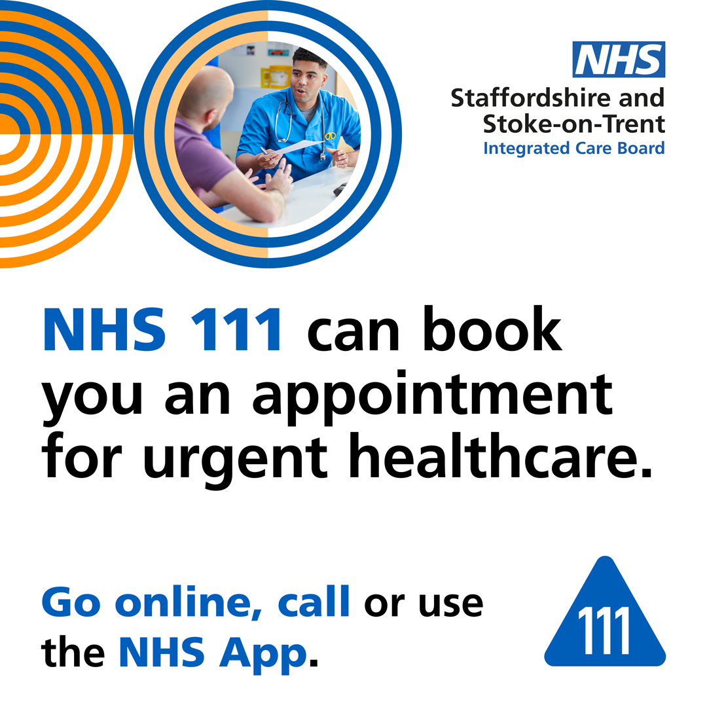
UEC-111 assets

Slide 4
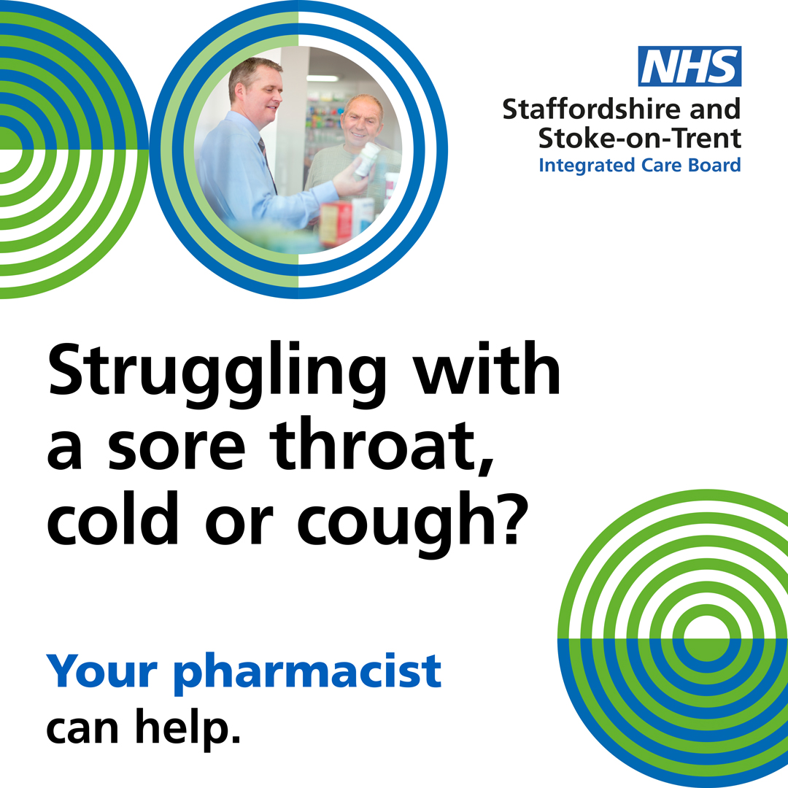
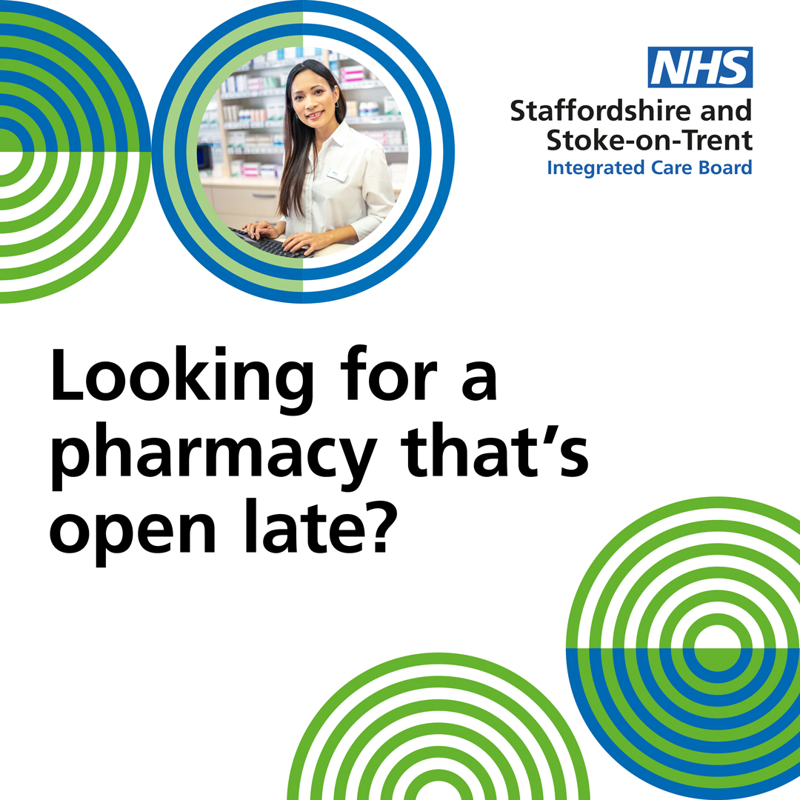
UEC- Pharmacy
Use the quick and easy NHS online tool to find a pharmacy in Staffordshire and Stoke-on-Trent and check its opening times: www.nhs.uk/service-search/pharmacy/find-a-pharmacy
Pharmacists can give you expert advice on medicines and looking after yourself at home, and you won’t have a long wait.

Slide 5
UEC- Dental Care
Need urgent dental care in the evening or at the weekend? Your dentist’s answering machine message may have useful advice. Or contact NHS 111 to find an out-of-hours service near you: www.111.nhs.uk
Not sure where to go for urgent dental treatment? Call the Staffordshire Dental Advice Line on 0300 123 0981 or contact NHS 111: www.111.nhs.uk
NHS 111 can advise on where to get out-of-hours dental treatment in Staffordshire and Stoke-on-Trent. They can also offer advice on pain relief. You can go online at www.111.nhs.uk, call or use the NHS App.

Slide 6
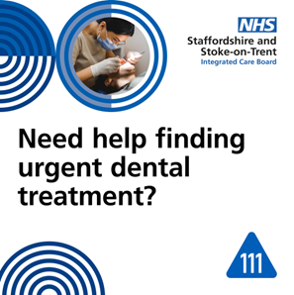
UEC – Dental Care assets

Slide 7
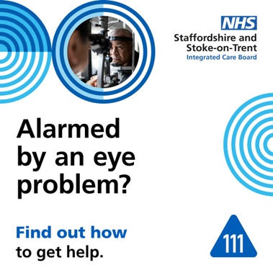
UEC – Eye Care
If you have sudden vision loss, or an eye problem like flashes or floaters, the Community Urgent Eyecare Service can provide urgent appointments. If you’re registered with a GP in Stoke-on-Trent or Staffordshire (except East Staffordshire), you can book directly with an optometry practice that offers the service. Some practices have appointments in the evenings and at weekends. Look online at https://primaryeyecare.co.uk/find-a-practice/
If you need urgent treatment for an eye injury or a condition that developed suddenly, and you’re not sure where to get help, contact NHS 111. Go online at www.111.nhs.uk, call or use the NHS App.

Slide 8
UEC – Mental Health
For support in a mental health crisis, day or night, call one of our urgent mental health helpline numbers:
North Staffordshire: call 0800 032 8728
South Staffordshire: call 0808 196 3002
If you or a loved one need urgent mental health support in North Staffordshire, help is available 24/7. Call our helpline on 0800 032 8728 or visit this website for information: https://www.combined.nhs.uk/our-services/adult-community/crisis-care-centre/
If you or a loved one need urgent mental health support in South Staffordshire, help is available 24/7. Call our helpline on 0808 196 3002, or email mhsi.staffordshire@mpft.nhs.uk. More information is available at https://www.mpft.nhs.uk/emergency-help

Slide 9
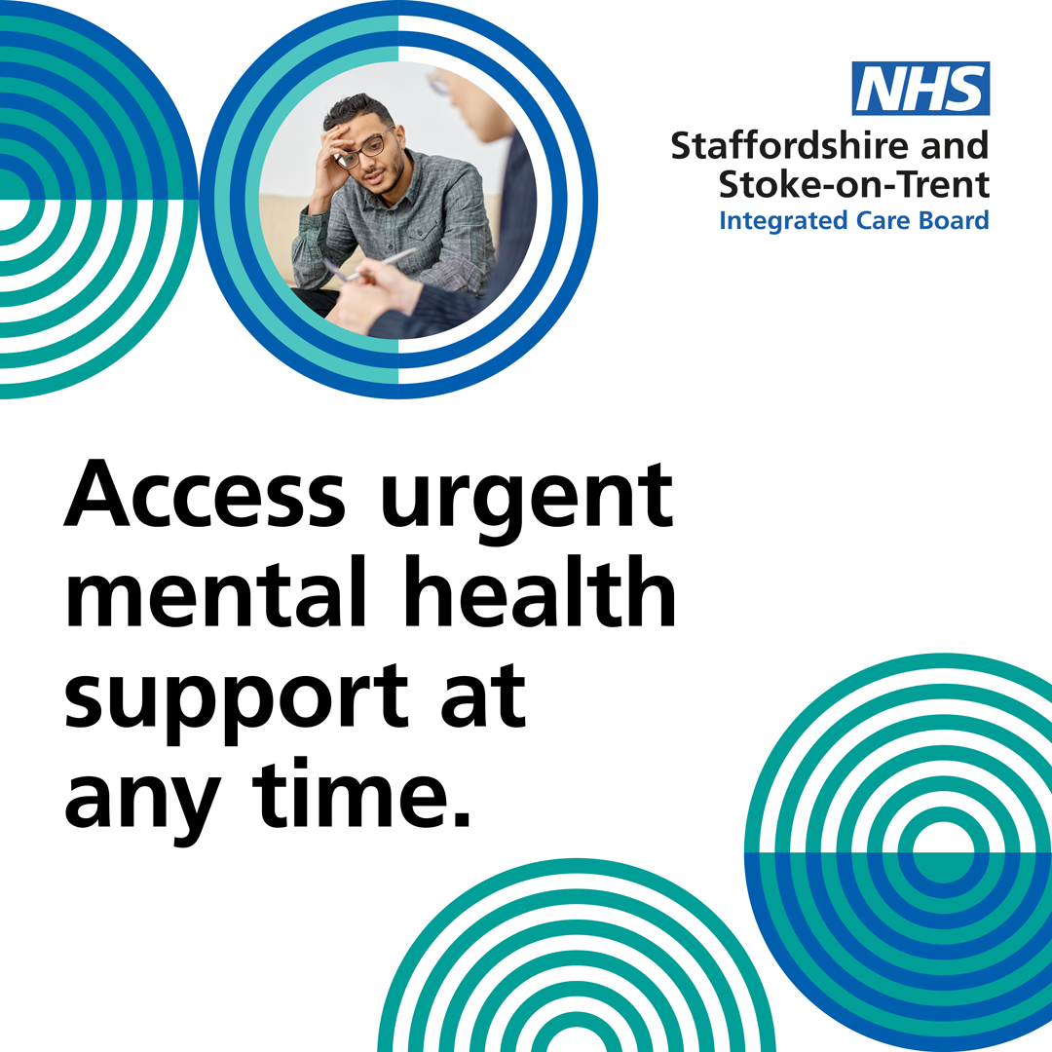
UEC – Mental Health assets

Slide 10
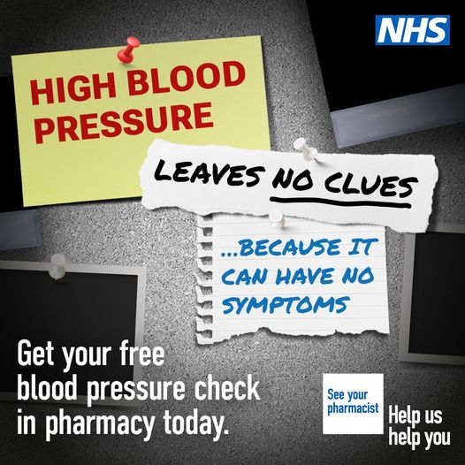
Pharmacy – blood pressure
You can get your blood pressure checked at a pharmacy for free, you don’t need to see a GP. Find a pharmacy near you offering this service https://www.nhs.uk/nhs-services/prescriptions-and-pharmacies/find-a-pharmacy-that-offers-free-blood-pressure-checks/
If you are over 40, without a history of high blood pressure, and have not had your blood pressure measured by a health professional in the last six months, you can receive a free check at your local pharmacy. https://www.nhs.uk/nhs-services/prescriptions-and-pharmacies/find-a-pharmacy-that-offers-free-blood-pressure-checks/
High blood pressure significantly increases the risk of having a heart attack or stroke. Contact your local pharmacy for a free blood pressure check. https://www.nhs.uk/nhs-services/prescriptions-and-pharmacies/find-a-pharmacy-that-offers-free-blood-pressure-checks/

Slide 11
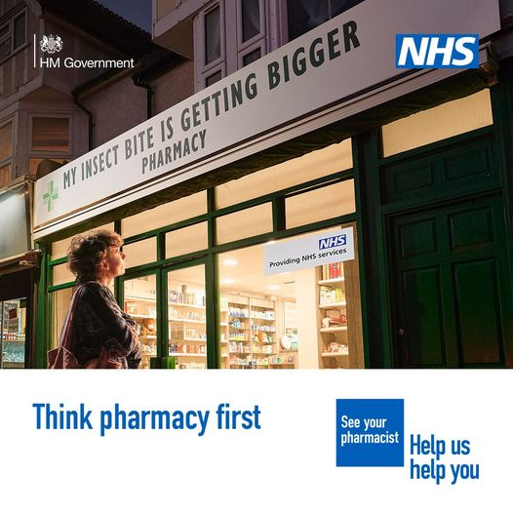
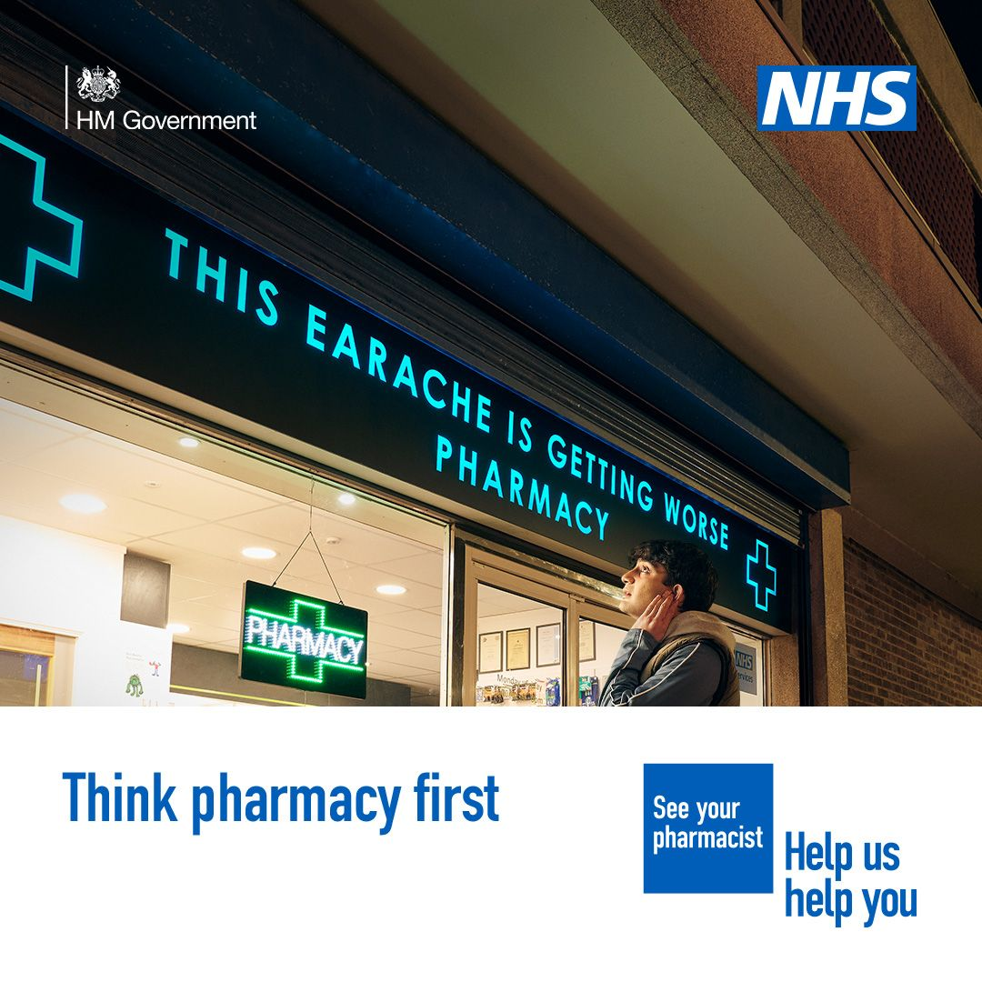
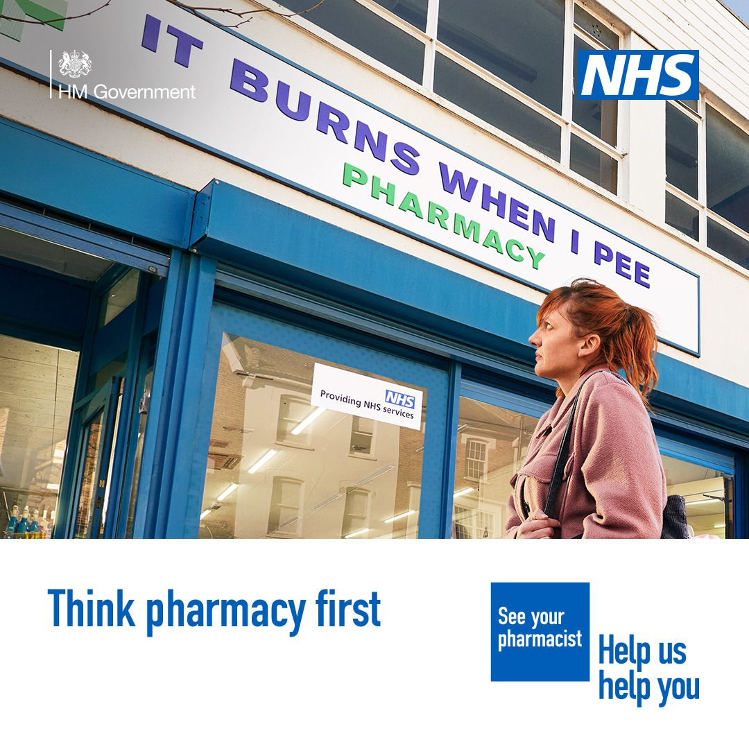
Think Pharmacy first
Earache, insect bite, UTI? If needed, your pharmacist can now provide some prescription medicine without seeing a GP.
Think pharmacy first.
http://nhs.uk/thinkpharmacyfirst

Slide 12
Think pharmacy first – summer
Did you know you can visit a pharmacist instead of your GP for advice and treatment on a range of minor illnesses.
You can now visit a pharmacist for advice and treatment for earache. Does your child have earache? Redness? Inflammation and soreness?
You can now visit a pharmacist for advice and treatment for impetigo. Common in young children, impetigo is a skin infection which often gets better in seven to 10 days with treatment.
You can now visit a pharmacist for advice and treatment for infected insect bites. Do you have an insect bite? Sometimes they can look red and swollen and feel hot.
You can now visit a pharmacist for advice and treatment for shingles. Shingles can cause a painful rash.
You can now visit a pharmacist for advice and treatment for sinusitis. Sinusitis is the swelling of the sinuses.
You can now visit a pharmacist for advice and treatment an ongoing sore throat. Sore throats are very common and usually get better by themselves within a week.
If you’re a woman aged 16 to 64 you can now visit a pharmacist for advice and treatment for a urinary tract infection (UTI). Think you have a UTI? Pain or a burning sensation when peeing? Needing to pee more often and pee that looks cloudy, dark or has a strong smell?
NHS England — Midlands » Pharmacy first resources

Slide 14
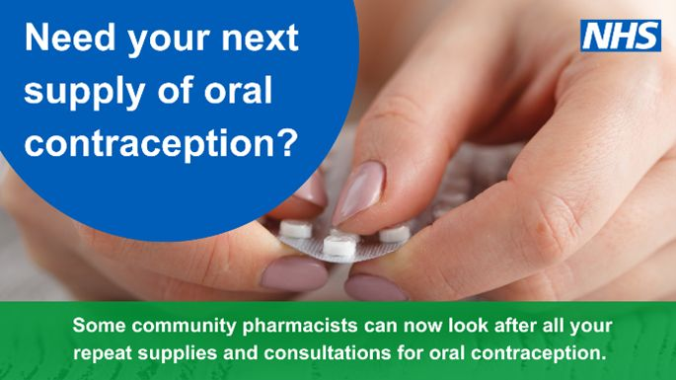
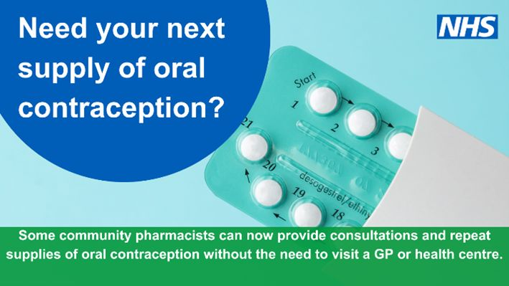
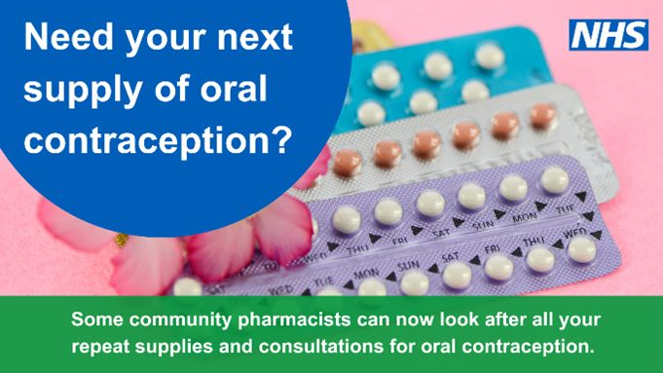
Oral Contraception
A community pharmacy can now look after your repeat supplies of oral contraception and offer consultations. Find out more https://www.england.nhs.uk/.../pharmacy-contraception.../
If you need a repeat supply of your oral contraception, your local pharmacy could help. https://england.nhs.uk/midlands/…

